Slide 1
Results So Far
Sebastian

Slide 2
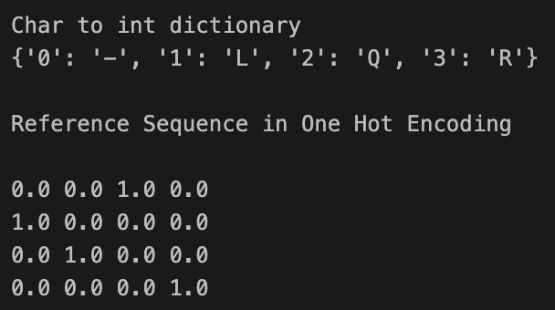
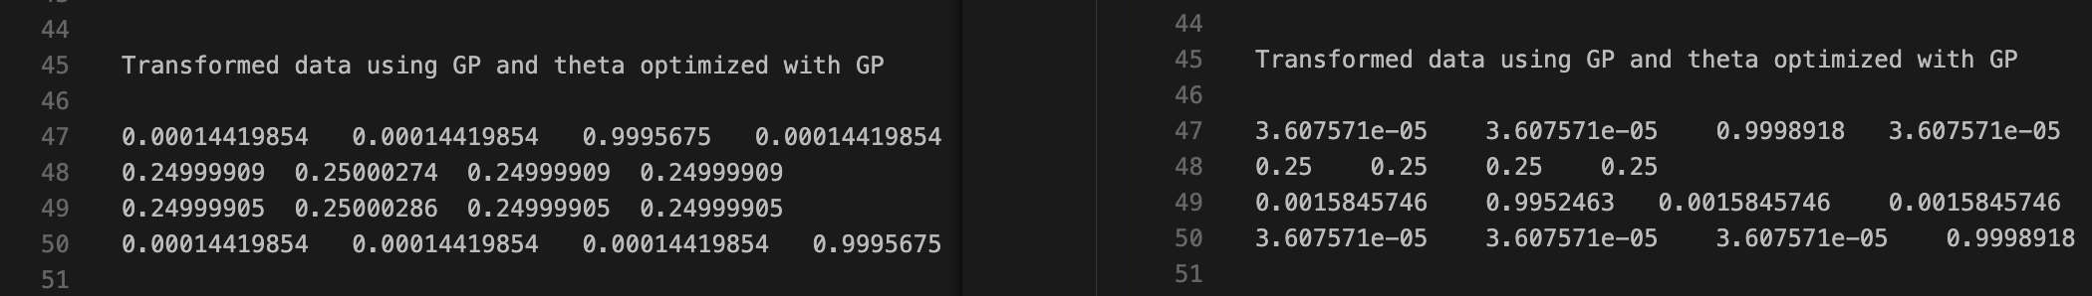
Case: One Gap
Reference
GAP
BEFORE
AFTER

Slide 3
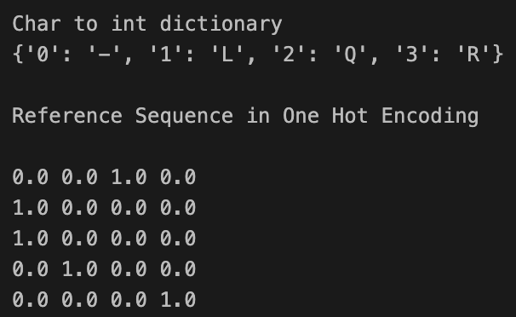
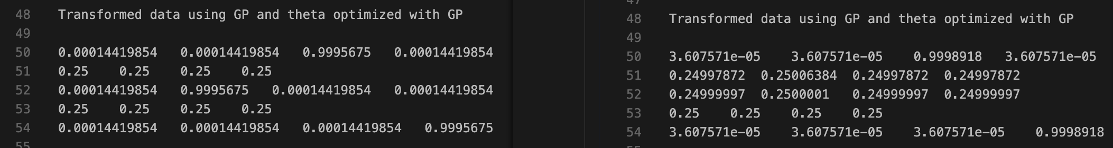
Case: Two Gaps
Reference
Red blocks are GAPS
????
BEFORE
AFTER

Slide 4
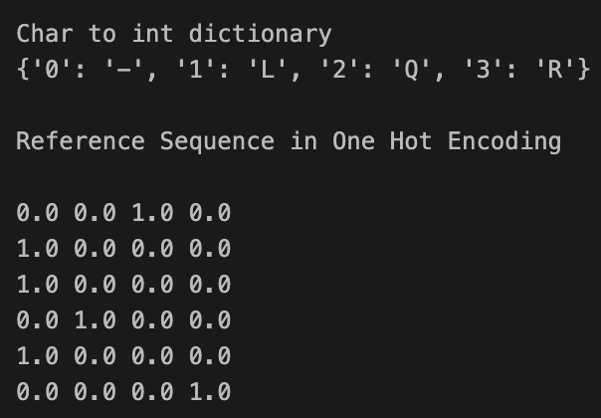
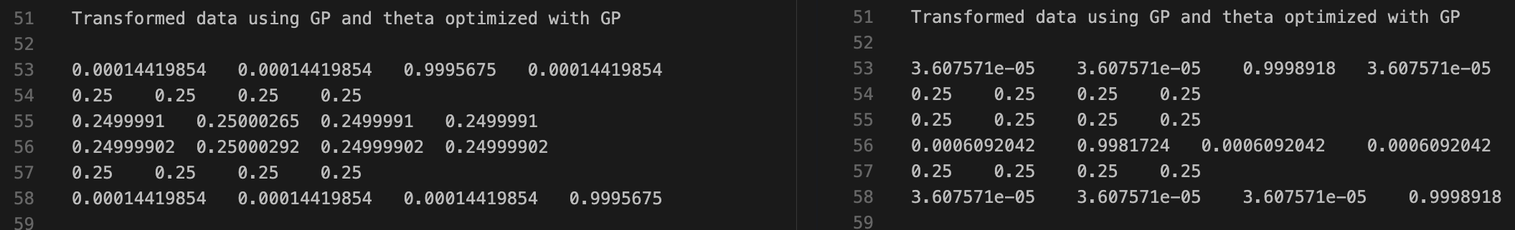
Case: Three Gaps
Reference
Red blocks are GAPS
BEFORE
AFTER

Slide 5
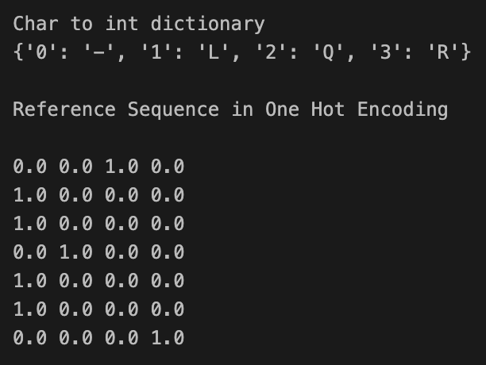
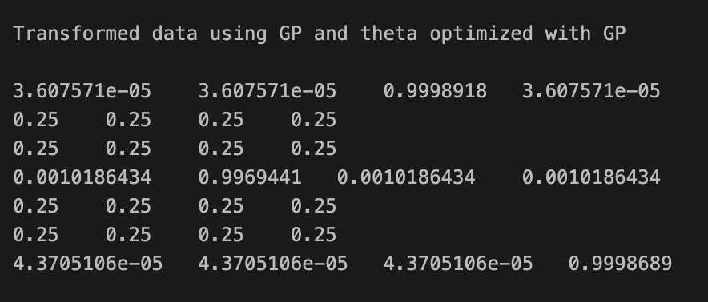
Case: Four Gaps
Reference
Red blocks are GAPS
GP CPAB

Slide 6
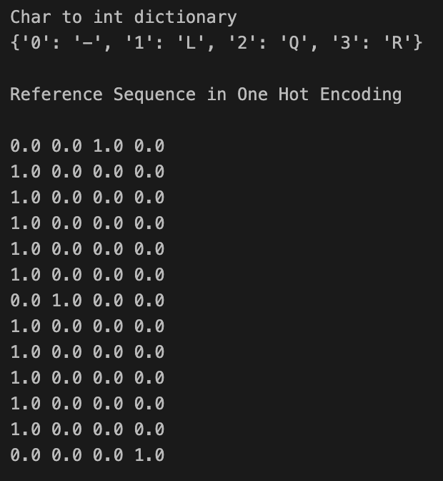
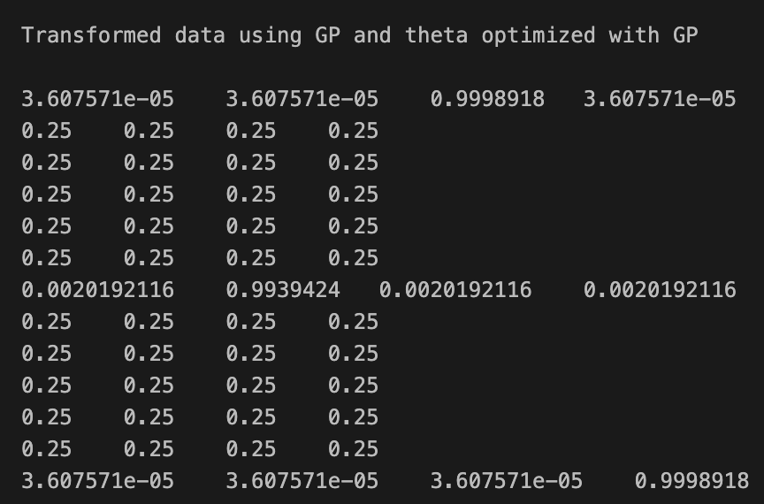
Case: Nine Gaps
Reference
Red blocks are GAPS
GP CPAB

Slide 7
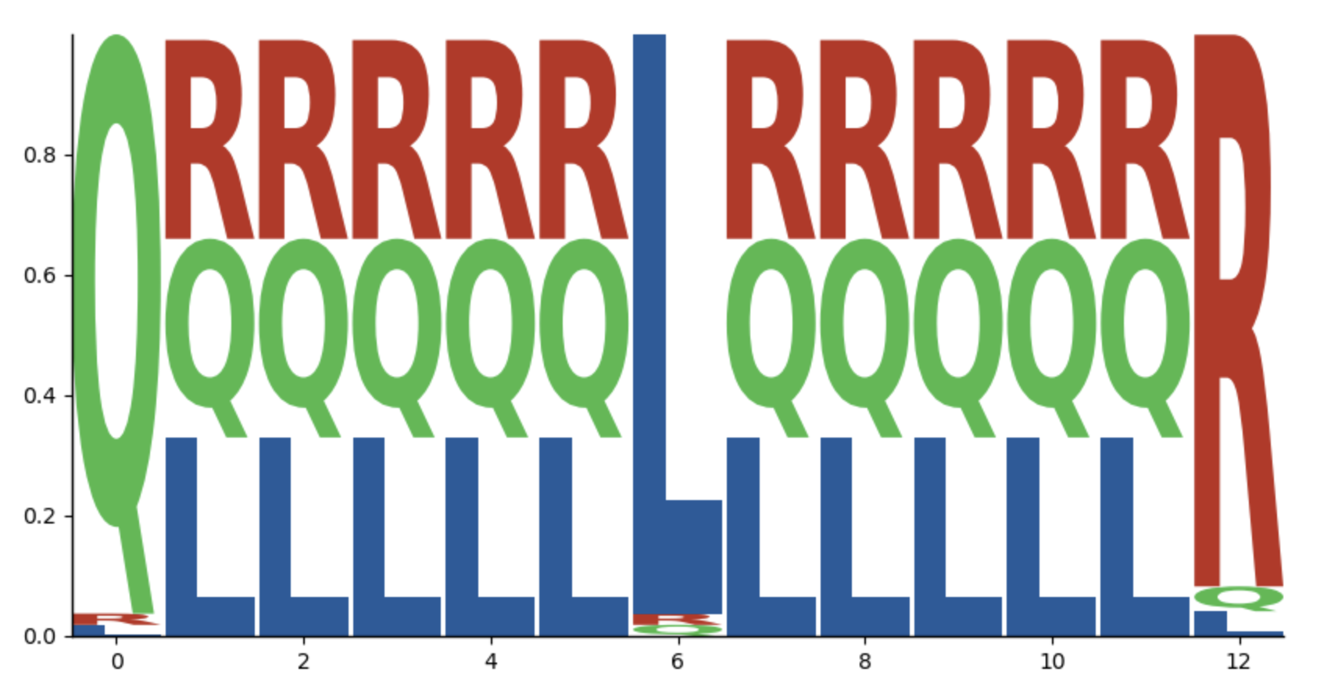
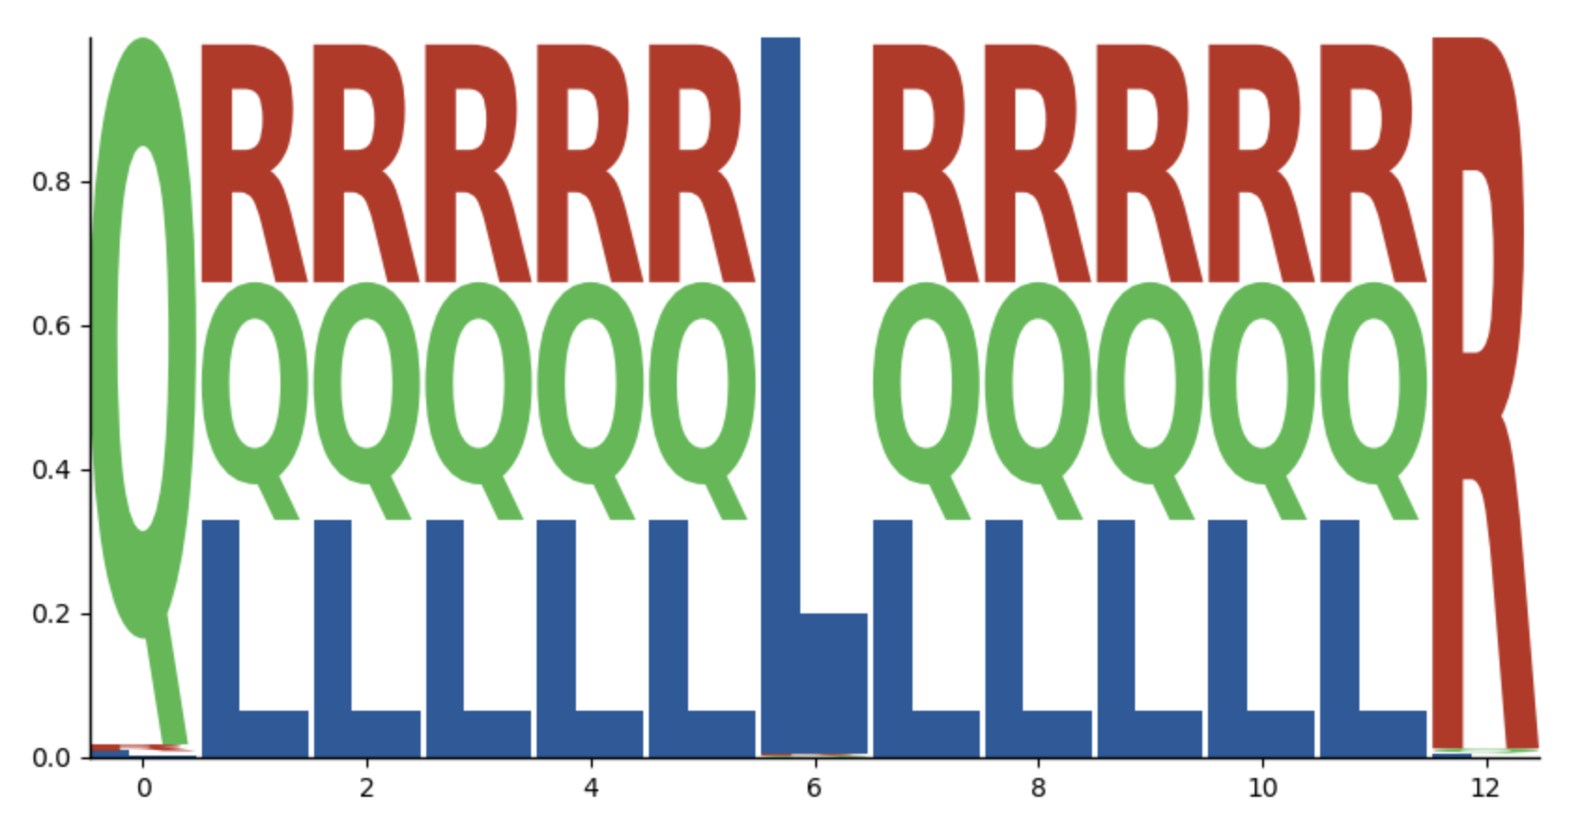
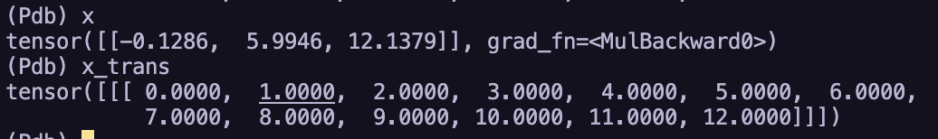
TESTS NO PADDING POSITIONS – SINGLE CASE (10 gaps)
Distribucion
Transformacion

Slide 8
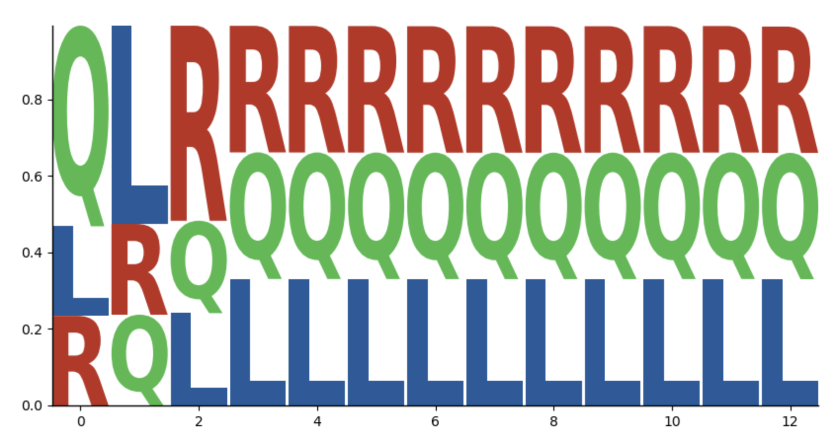
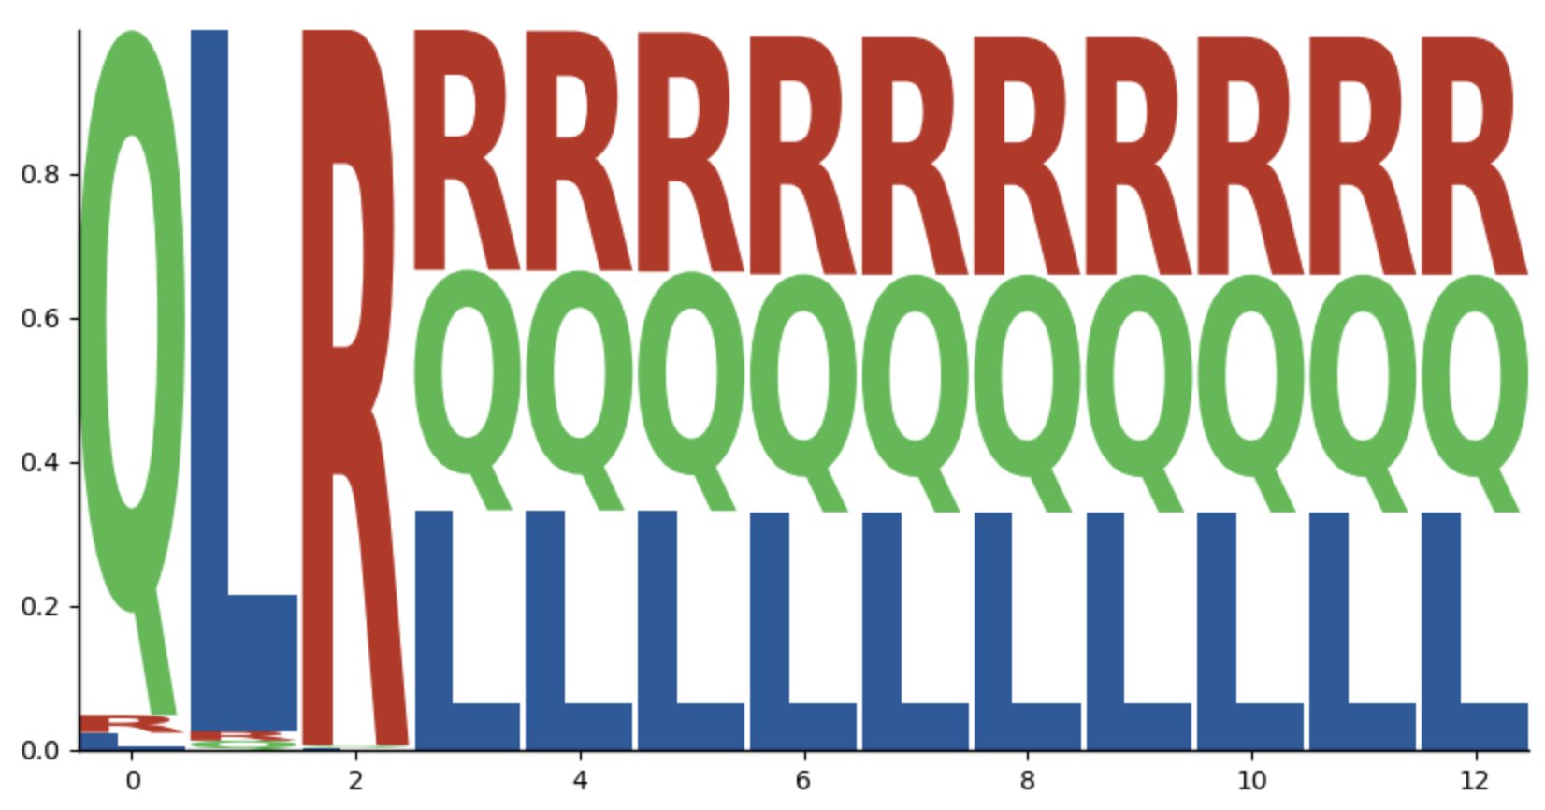
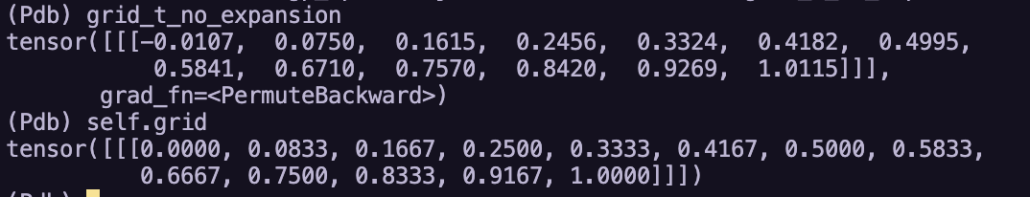
TESTS FOR PADDING POSITIONS – SINGLE CASE (10 gaps)
Distribucion
Transformacion

Slide 9
TESTS FOR PADDING POSITIONS – SINGLE CASE (10 gaps) NEW IDEA
Distribucion
Transformacion

